Slide 1
DOCTOR APPOINTMENT SYSTEM
Giselle Fernandes - 2308
Niyati Madgaokar - 2312
Swizel Monteiro - 2314

Slide 2
INTRODUCTION
In today's fast-paced world, access to healthcare services is paramount, yet often hindered by logistical challenges such as long wait times, scheduling conflicts, and administrative inefficiencies. To address these issues and enhance the patient experience, the Design and Development of an Online Doctor Appointment System becomes imperative. This project aims to revolutionize the way patients interact with healthcare providers by offering a comprehensive and user-friendly platform for scheduling appointments, managing medical records, and facilitating communication between patients and healthcare professionals.

Slide 3
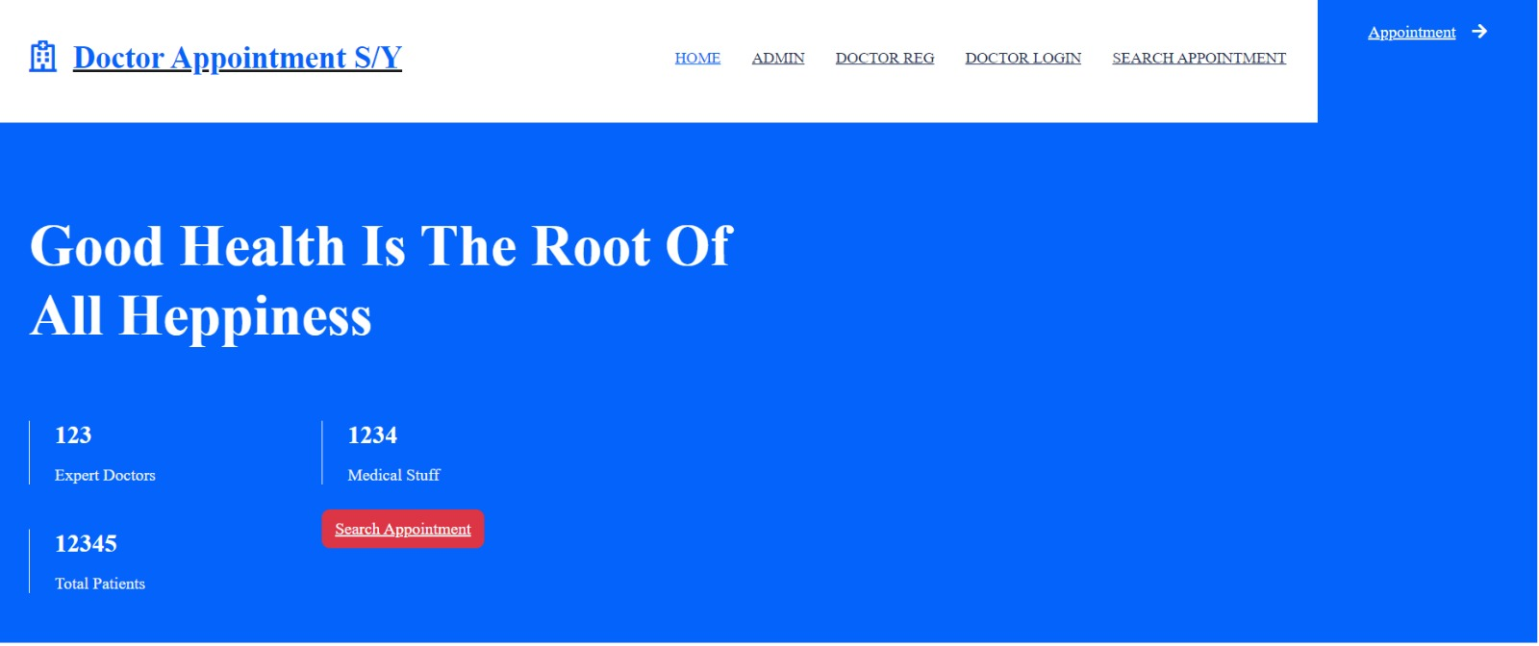
MAIN DASHBOARD
This gives a brief overview of the healthcare facility, including its mission, vision, and values. It includes the along with some key statistics describing the facility. The navbar includes User Registration and Login , and Appointment

Slide 4
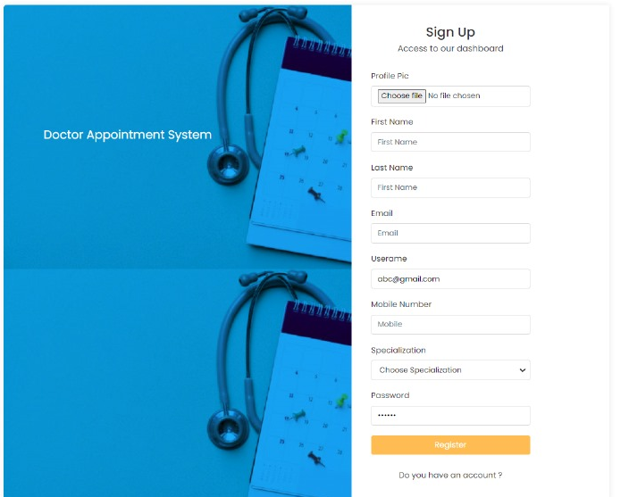
REGISTRATION
Allows admin ,doctors , users to register accounts with additional information such as specialization and profile picture.

Slide 5
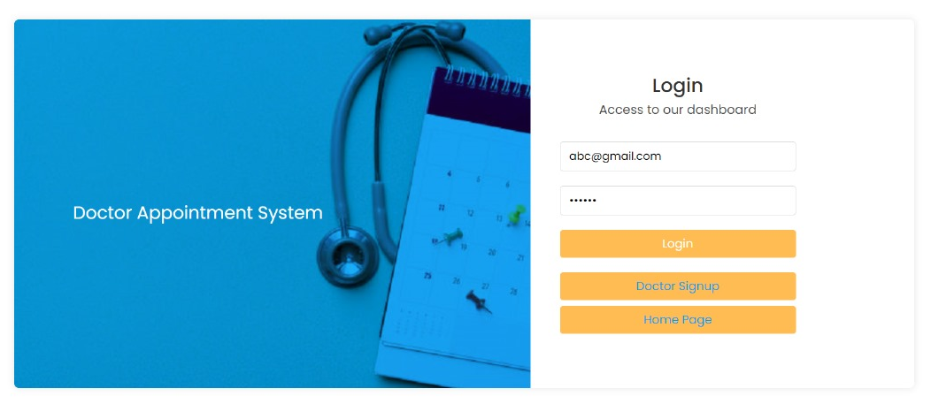
LOGIN
Allows admin ,doctors , users to register accounts with additional information such as specialization and profile picture.

Slide 6
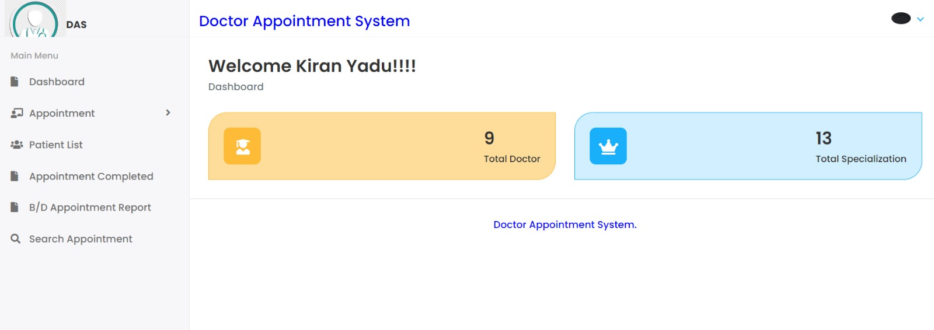
ADMIN DASHBOARD

Slide 7
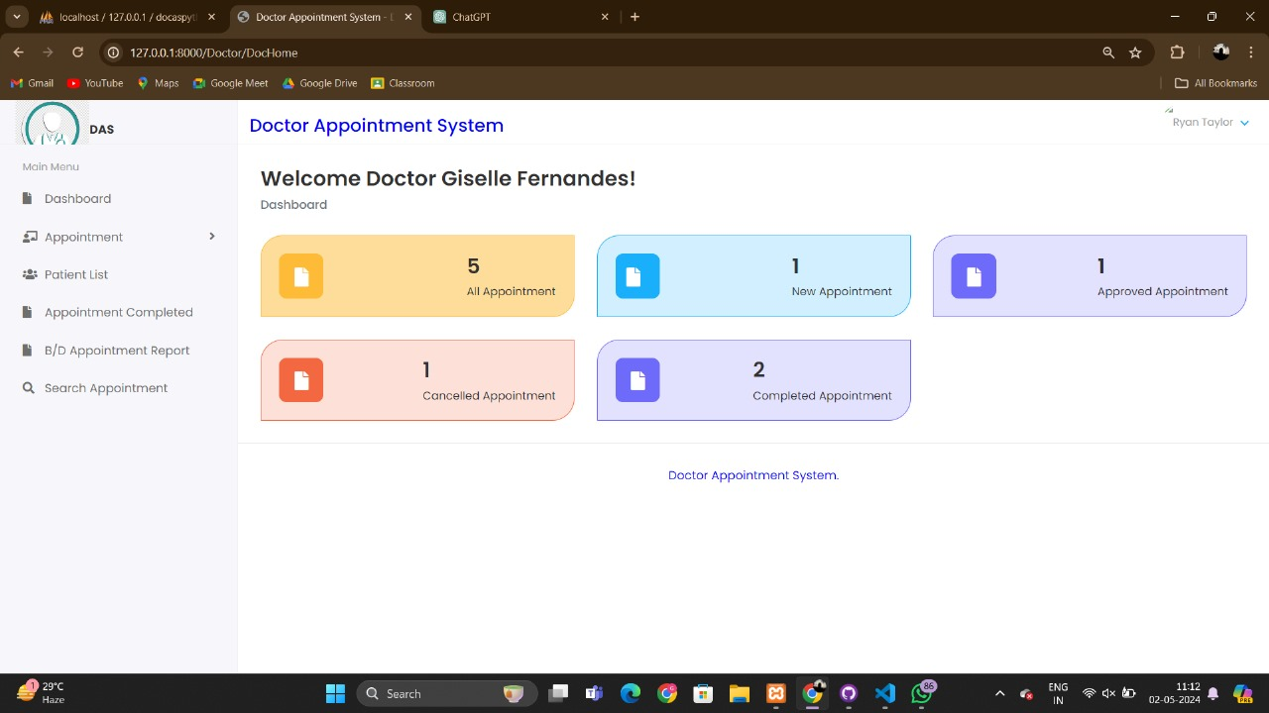
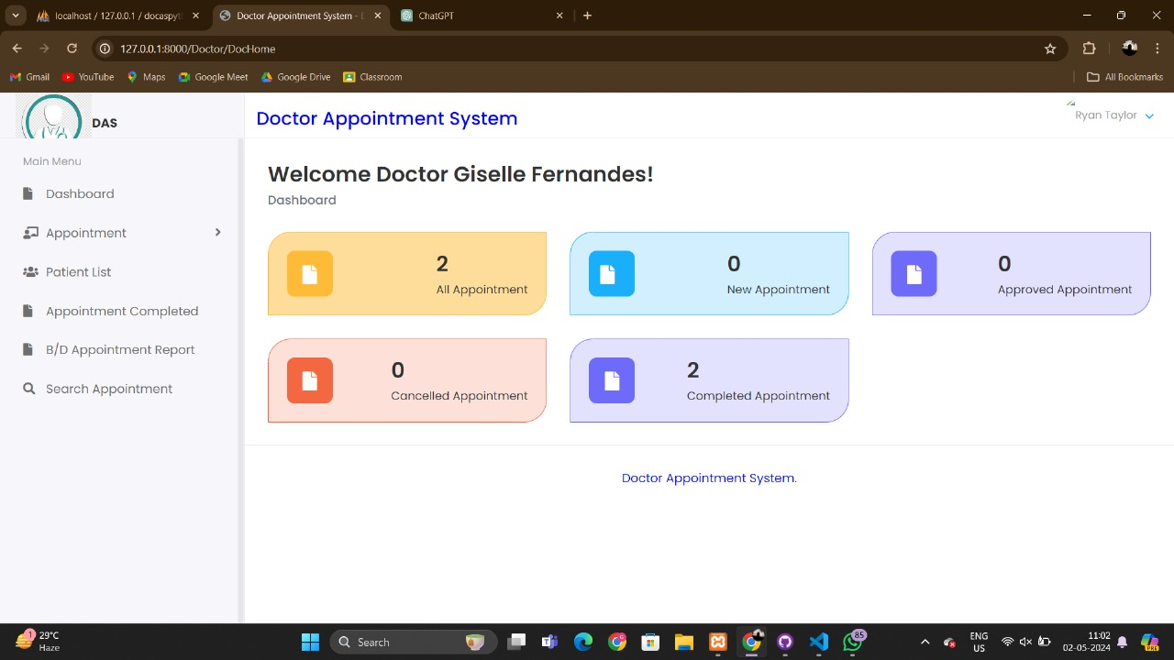
DOCTOR DASHBOARD

Slide 8
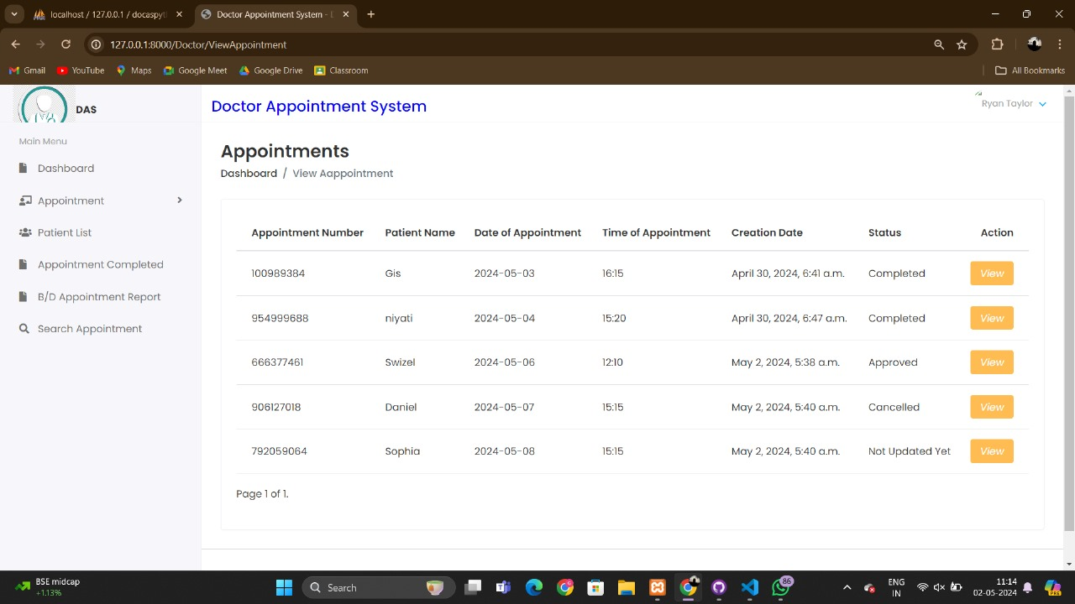
APPOINTMENT LIST

Slide 9
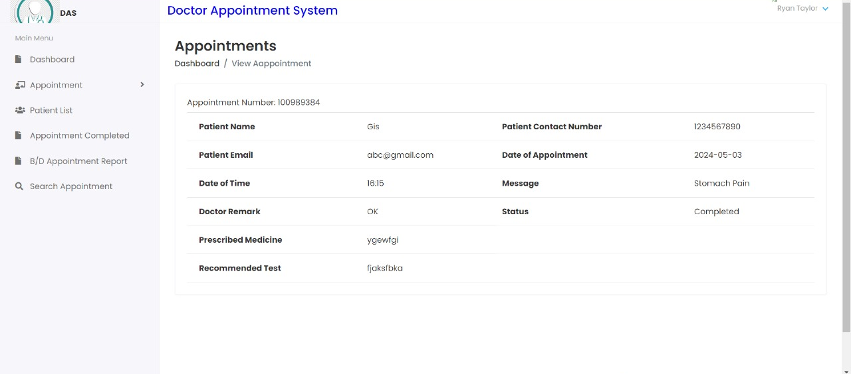
APPOINTMENT DETAILS

Slide 10
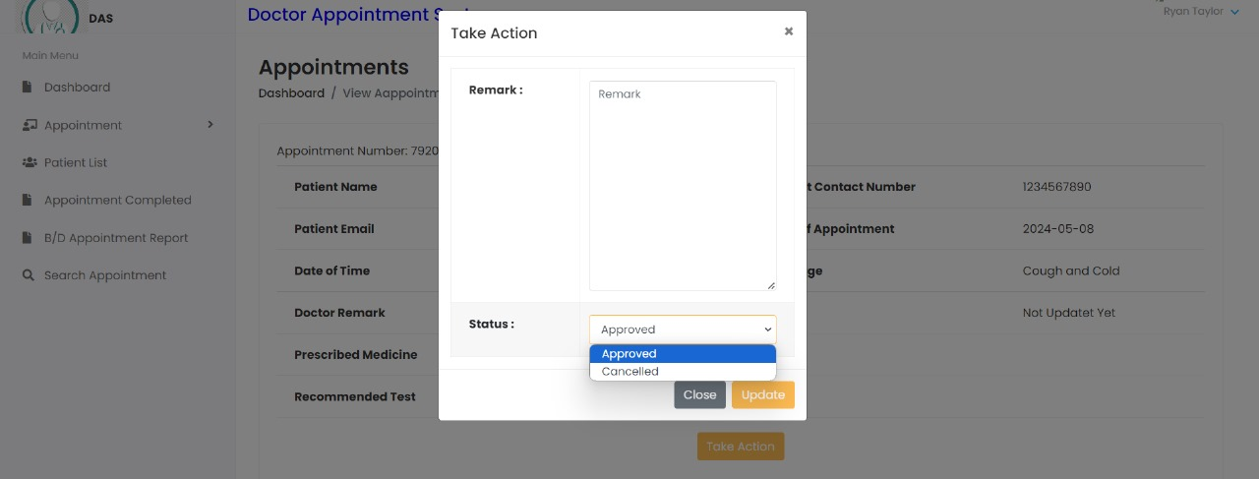
APPROVE/ CANCEL APPOINTMENTS

Slide 11
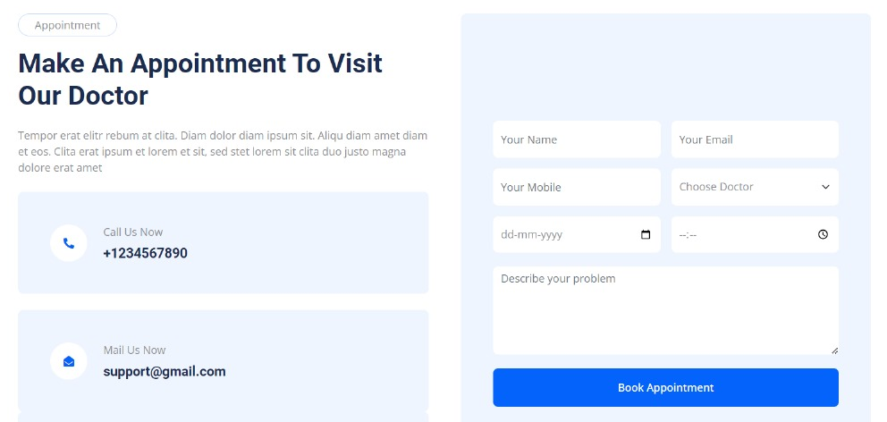
MAKING AN APPOINTMENT

Slide 12
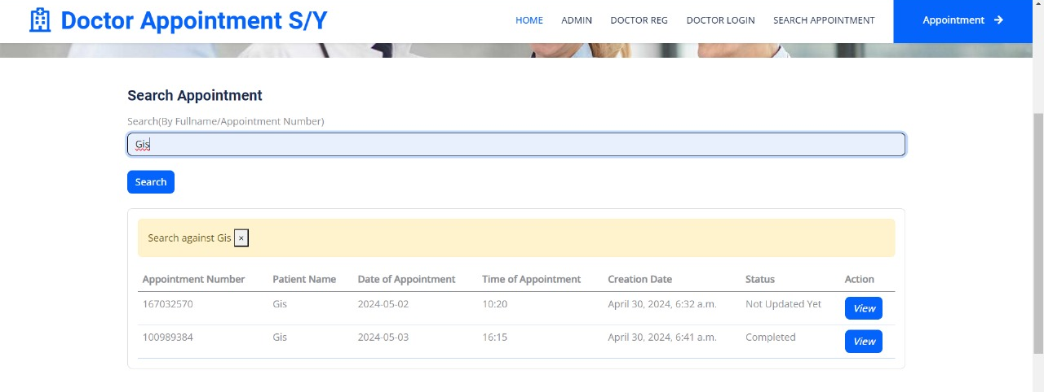
SEARCHING AN APPOINTMENT

Slide 13
TECHNOLOGIES USED
DJANGO
PYTHON
GITHUB
JIRA
HTML/CSS/SCSS/JS
MYSQL
SONARLINT
XAMPP

Slide 14
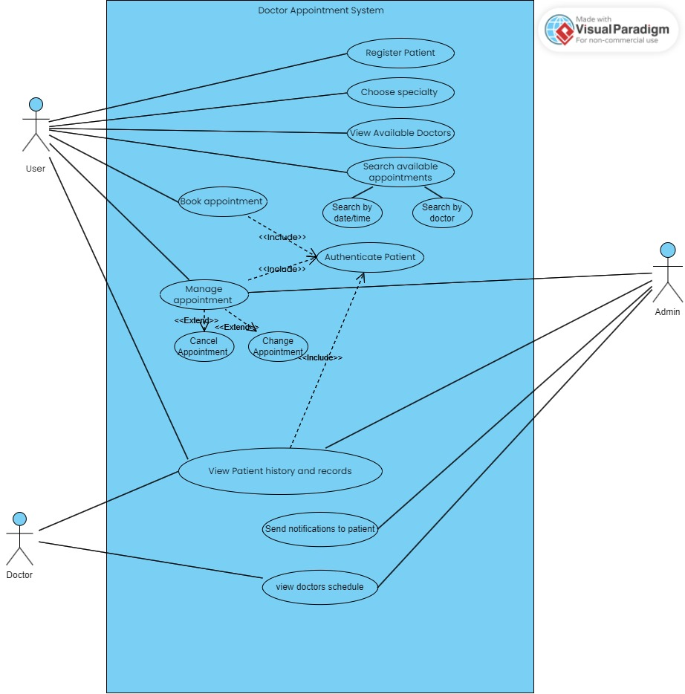
USE CASE

Slide 15
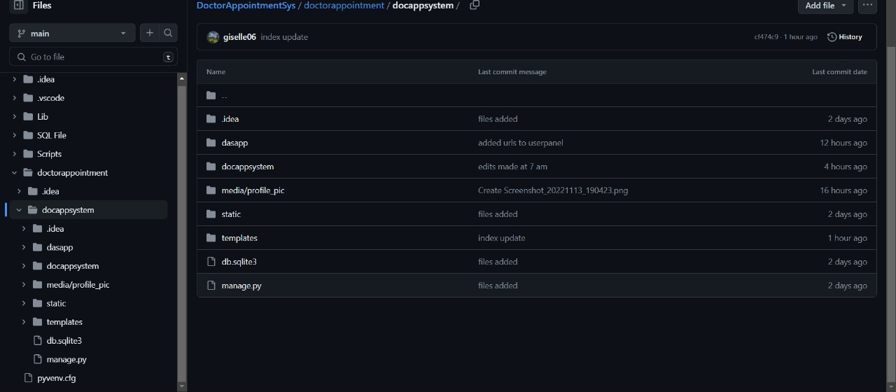
GITHUB

Slide 16
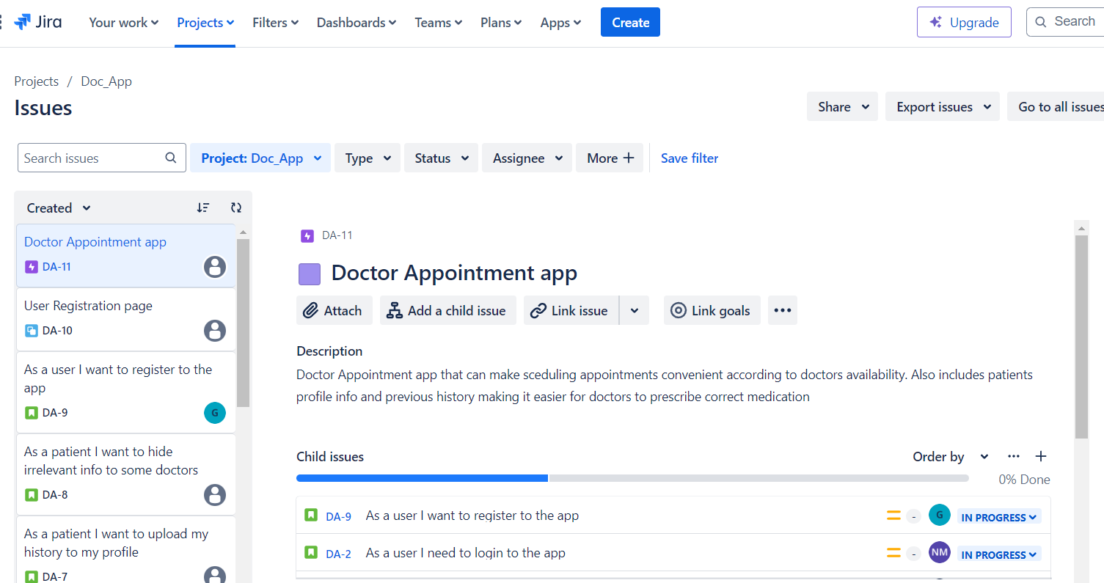
JIRA

Slide 17
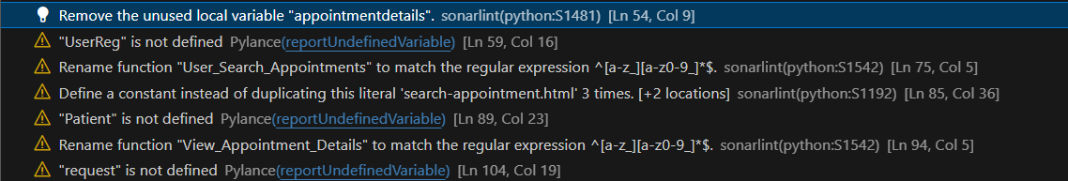
SONARLINT

Slide 18
CONCLUSION
The Online Doctor Appointment System represents a transformative step towards enhancing healthcare accessibility, efficiency, and patient satisfaction. By leveraging cutting-edge technology and adhering to best practices in software development, the system embodies the future of healthcare delivery, empowering patients and healthcare professionals alike to navigate the complexities of modern healthcare with ease and confidence.

